Slide 1
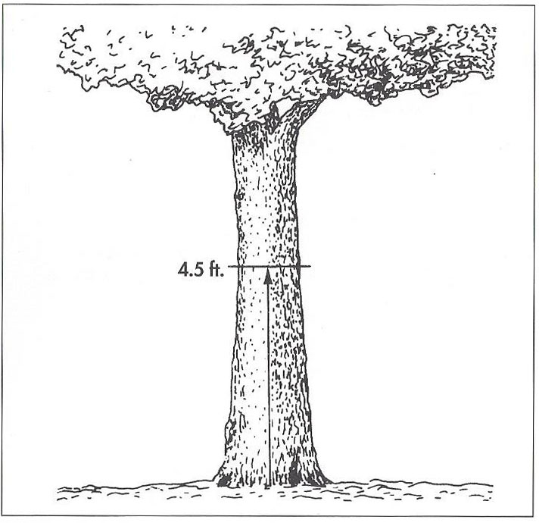
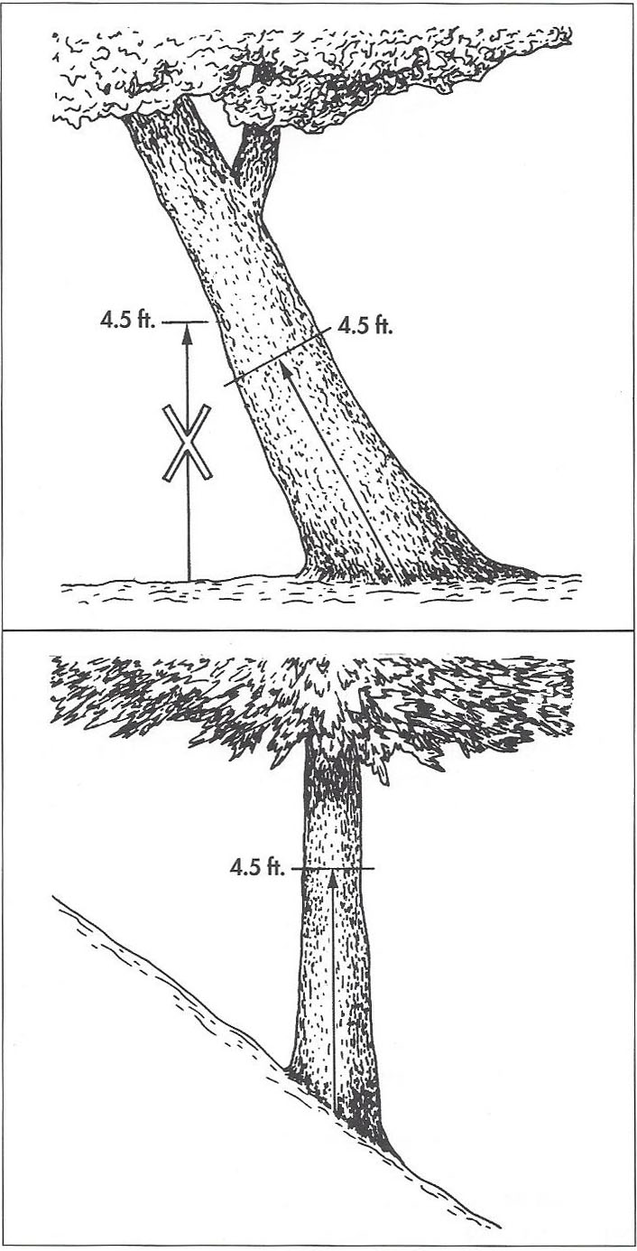
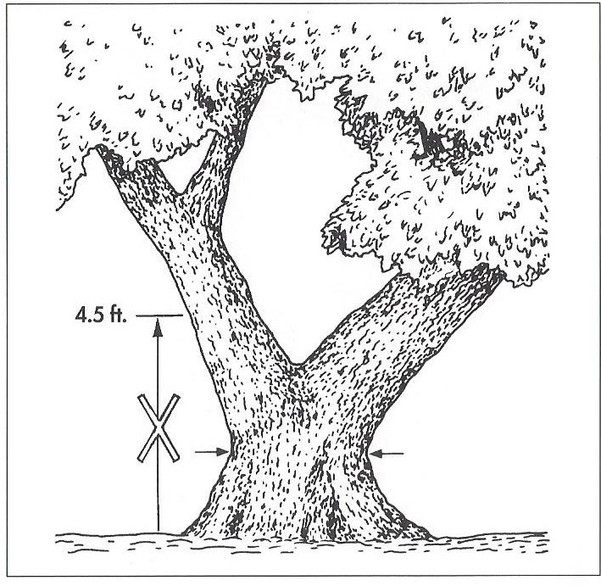
Figures for measuring trunk diameter (DBH). Note, for measurement on slopes, DBH is taken on the uphill side. Source: CTLA Guide for Plant Appraisal 9th Edition

