Slide 1
Data Collection
Demonstrate, Practice, Discuss

Slide 2
Going outside…
Everyone
Clipboard, paper, pencil
Friday data sheet
Inventory codes sheet
Team Leader
Who’s the lucky one…
Team Folder
Map by color group
Team Equipment
Diameter Tape
Biltmore
Diameter “string”
Team Alliances!
Jason – Blue & Green
Pam – Yellow & Red

Slide 3
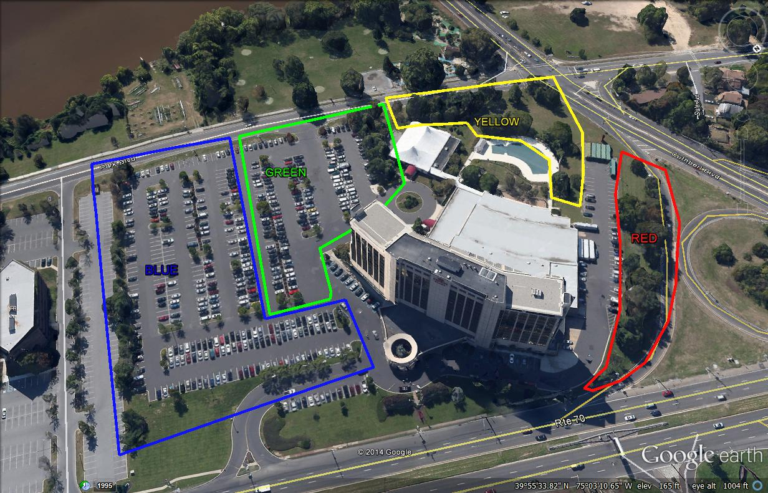
Map & Teams

Slide 4
Team Leaders
Prepare to represent your team with answers to the following questions:
What unexpected issue did you encounter?
How did you address the issue?
How could it apply to inventory in your town?
Questions?

Slide 5
Lets Go…

Slide 6
Practical Exercise
Developing Your Inventory Plan

Slide 7
Questions from outside?

Slide 8
Team Leaders
What unexpected issue did you encounter?
How did you address the issue?
How could it apply to inventory in your town?
Questions?

Slide 9
Homework…

Slide 10
Design an inventory plan for your municipality
What questions do you want to answer?
What type of inventory?
How will the data be used?
Who will collect the data?
What data will be collected?
How will data be collected?
What problems will you anticipate?
How will you prevent the anticipated problems?
Who will you share your data with?
What will you do next?

Slide 11
Homework…
Be prepared to share and discuss tomorrow!

