Slide 1
Inventory Training & i-Tree
Jason Grabosky, PhD
Pam Zipse, CTE
Rutgers University, SEBS, Urban Forestry Program

Slide 2
Welcome
The Inventory Training & i-Tree program was developed to address the need identified by the membership of the NJ Shade Tree Federation
The program was developed through a partnership between the NJ Shade Tree Federation, The NJ DEP Community Forestry Program, and Rutgers University.
Thank you for participating in this exciting new program!

Slide 3
Welcome
This program is intended to prepare participants to design and conduct a volunteer municipal street tree inventory.
We will stress the need to understand the data you are collecting and what it means to your inventory.
We will stress the need to be reasonable and realistic about the data you plan to collect, and the importance of knowing what each piece of data collected will be used for.
We will discuss the uses and limitations of i-Tree, and how to design your inventory to be compatible.

Slide 4
Welcome
We will be filming for the purpose of creating web casts that you can refer back to later.
Our intention is to focus the filming on the presenter and the slides, however we are likely to film some backs of heads and crowd shots, especially in the outdoor sessions.
If you have a specific objection to being filmed, please let us know and we will do our best to avoid you.
If you are filmed, you will be approached for consent to use the footage.

Slide 5
Introductions
Dr. Jason Grabosky, Professor, Rutgers - Urban Forestry
Pam Zipse, CTE # 426, Rutgers, Hometown Forests, LLC
Dr. Rebecca Jordan, Assoc. Professor, Rutgers – Citizen Science
Dan Betz, Masters Student, Rutgers SEBS
Dan Clark, PhD Student, Rutgers SEBS
Amanda Sorensen, PhD Candidate, Rutgers SEBS
Lynn Fleming, Director/State Forester, State Forestry Services
Alexander McCartney, Urban Forestry Coordinator, SFS
Wayne Dubin, NJ CTE #433, VP / Division Manager, Bartlett
Jay Kaplan, NJ CTE # 587, Vegetation Manager, PSE&G

Slide 6
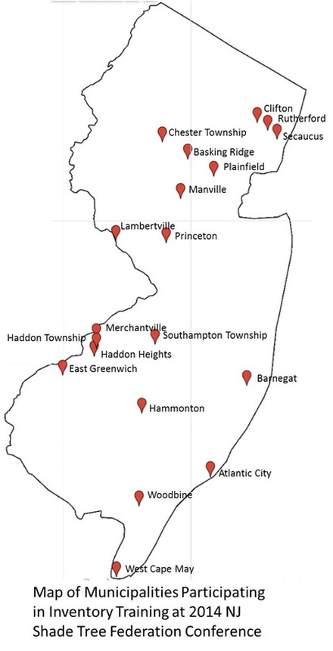
Introductions
All of you!

Slide 7
Introductions
Inventory Teams …
Look at your name badges and note the round stickers below your name.
The color of the sticker indicates your inventory team. The first color is for today, the second is for tomorrow.
You will work with this team over the next two days.

Slide 8
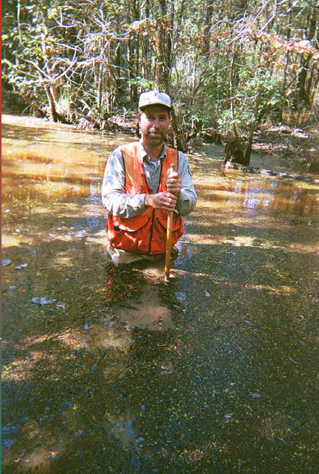
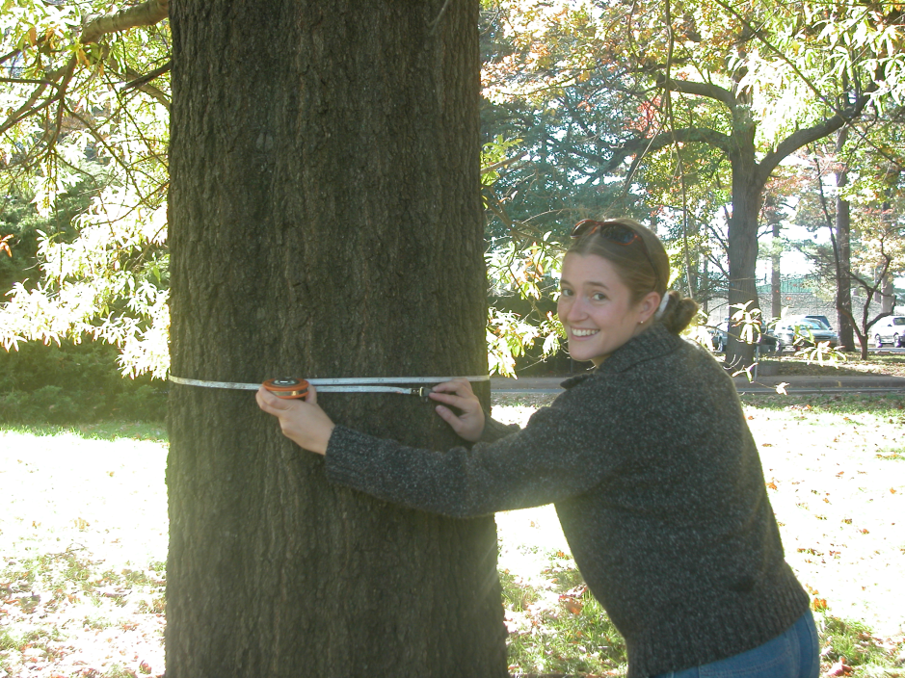
Agenda
Two days of inventory fun!

Slide 9
Getting Started
DBH
Where is DBH on you? Don’t Forget!
Folders
data sheets, species codes, notes
Team Leader
Any volunteers???
Inventory equipment
Maps, Diameter tape, Biltmore stick, creative alternatives…
Poll Everywhere…

Slide 10
Poll Everywhere
Group participation!
Use your cell phones to text us answers to poll questions throughout the course.
Standard text messaging rates apply.
Number of polls..

Slide 11
Poll Everywhere

Slide 12
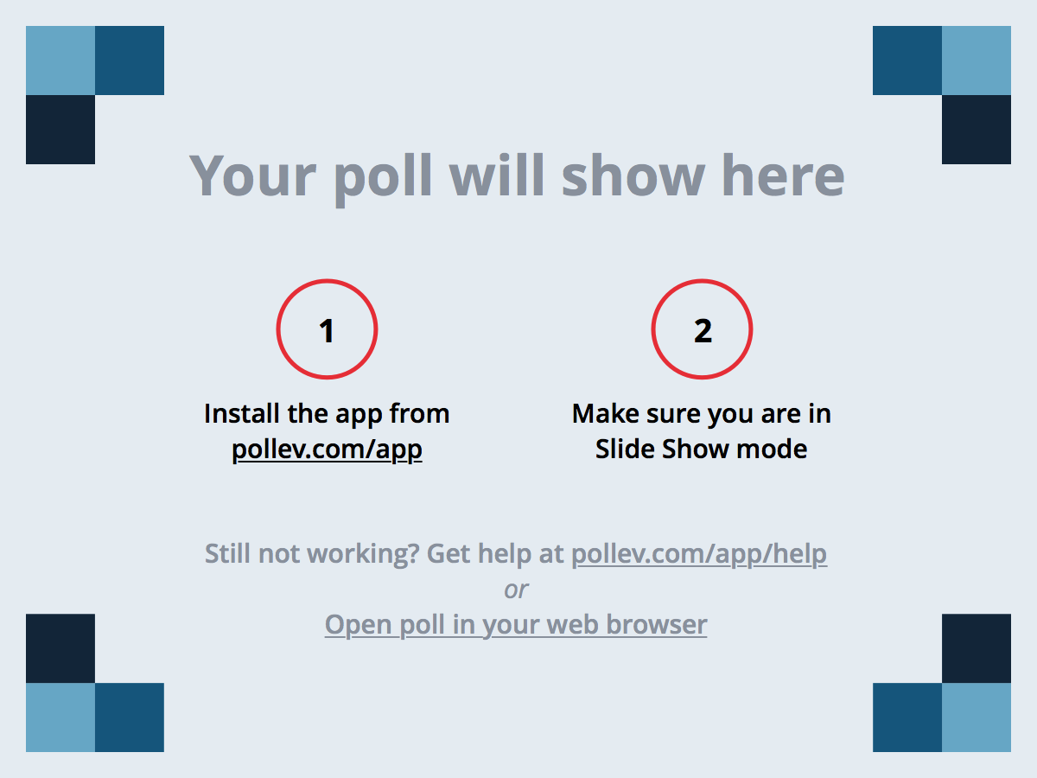
Notes:
Poll Title: What do you hope to learn over the next two days? https://www.polleverywhere.com/free_text_polls/32b7ksU7VXas0DL

Slide 13
Notes:
Poll Title: Does your municipality have a tree inventory already? https://www.polleverywhere.com/multiple_choice_polls/f3BbFmw28oEUN5P

Slide 14
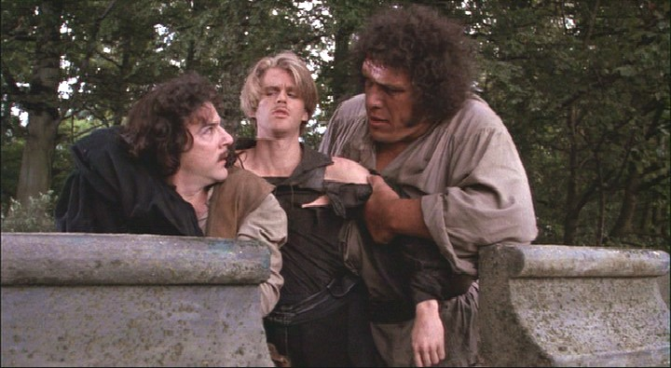
What is an inventory?
Counts and measures
A base platform to inform management choices
A tool from which to track performance of components and a total system of many parts
Tracking sales/quality/longevity in the grocery store

Slide 15
What is an inventory?
If you remember THREE things:
Keep it simple. For specific new questions, go back for details as they come.
It’s only data; it is not management in itself
It is a slice in time, so return periods of same data allows for analysis on changes and progress….yup you do this periodically, so keep it simple (#1)
Ok, so there are 4, counts and observations in graphs or charts represent clouds, not points once we start using data for management….there is ALWAYS variability
Oops there are 5, DO NOT fall into a trap of measuring beyond your ability to manage….a false sense of precision versus management inference ability
Shoot darn heck…..remember also to…….

Slide 16
The role of i-Tree…
i-Tree enables basic graphic communication on some inventory demographic questions
As a forest service product, there is the ability to suggest an authority behind your statements based on the data analysis
The suite of tools is meant to be helpful for communities in decision-support and advocacy/planning
i-Tree IS NOT management software (which rests on the same inventory foundation)
i-Tree forces a uniform data stream for the USFS (or your local Land Grant university) to vacuum into larger regional data sets and analyses through data sharing

Slide 17
The role of i-Tree…
It has been suggested its early role for communities is as a sales tool, for some of the inventory-base applets
The storm applet enables FEMA-base accepted emergency management preparedness
It is ultimately a series of a la carte black-box analyses with many underlying assumptions, which can be challenged in the model and in your data quality
For consultants and vigorous volunteers, the modelling can be very helpful, but you need to challenge the assumptions before blindly endorsing model outputs

Slide 18
Things to come…
Web site
Web casts
Information and links
Partnerships and sharing information
Your participation…
EAB Risk Map
i-Tree Storm

Slide 19
Lets get started!
Human Histogram…

